Slide 1
Rotary Small Grants (East Indonesia) Project
A Strategic Partnership between Rotary, Rotaract and Interact Clubs and NTA (East Indonesia) Aid

Slide 2
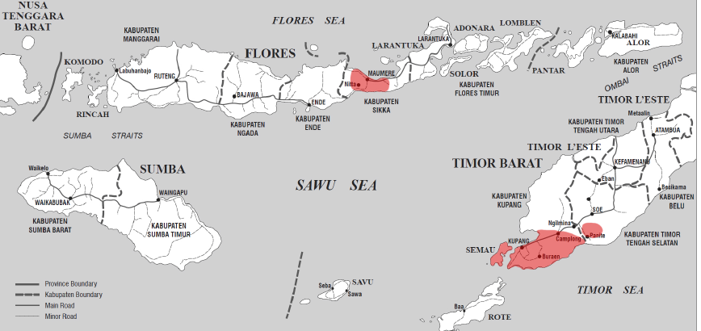
Eastern Indonesia
Closest neighbours – 450 Km away
Some of the poorest people in the world - 30% < poverty line
Malnutrition - stunted growth in 36.8% pop
Infant mortality and life spans - amongst worst in Indonesia
14,500 Under 5s die each year of diarrhoea
40% children do not attend school
“The hunger season” - 8 month dry season
Nusa Tenggara Timur Province, Indonesia

Slide 3
Rotary Small Grants (East Indonesia)
Fits four Rotary International focus areas
- Provide clean water, sanitation and hygiene
- Support education
- Grow local economies
- Fight disease
3 year project with goal of raising $30,000 and implementing 100 projects
Multi-club / generational project in District 9710 (Interact, Rotaract, Rotary)
Coordinating Club – RC Belconnen - $2,000 committed for three years
6 other sponsor Clubs committing to $1,000 per year
Separate fund-raising of $2,000 (Dinner, Quilt Raffle, Individual/Corporate Donations )

Slide 4
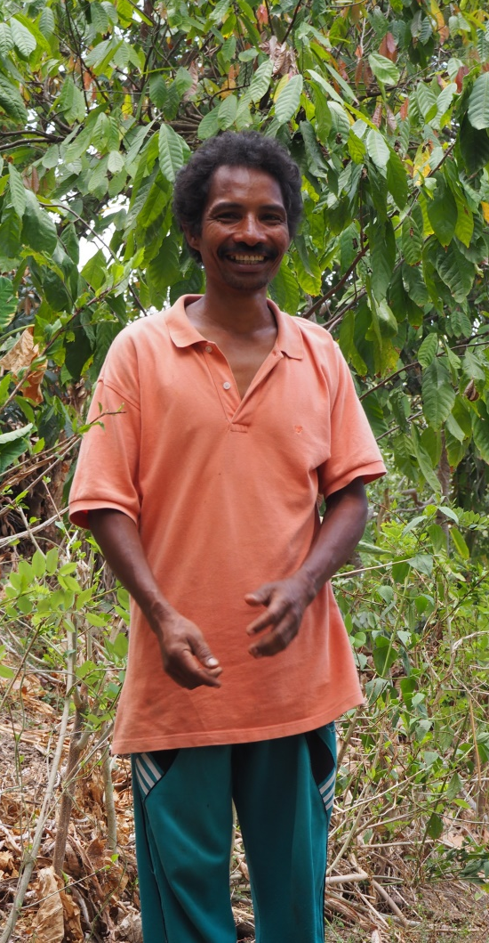
Strategic Partner NTA East Indonesia Aid
Vision
An improved level of livelihoods and food security of small rural households in selected parts of Nusa Tenggara Timur Province, East Indonesia.
History
25 years implementing aid programs in eastern Indonesia
Strong volunteer support - less costs, maximum “bang for buck”.
Continual rotation to new villages

Slide 5
Rotary Project Model
3 year focus on construction of water tanks, toilet / washing blocks, irrigation systems, crop fencing and school library books
RC Belconnen identifies partner donating clubs in District 9710
Identify 30 projects each year in association with NTA
Clubs select their individual projects
Implement projects through NTA and local partners
- Fund the purchase of local materials
- Construction by local families and communities
Monitoring visit NTA and Rotary volunteers (twice a year)
Completion report and photographs

Slide 6
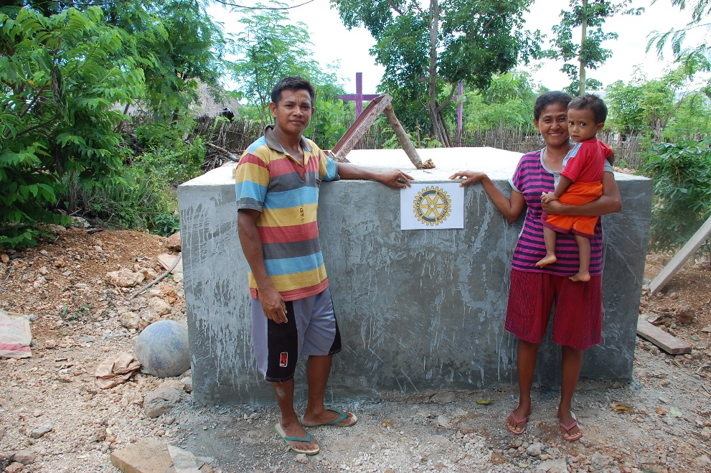
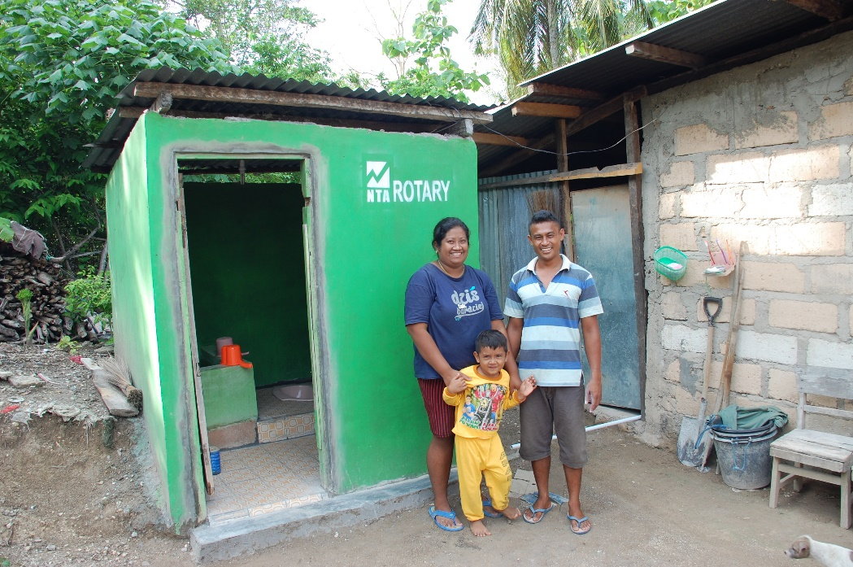
Water and Sanitation
What we do:
Grants for local communities to construct sustainable
wells
tanks
toilets

Slide 7
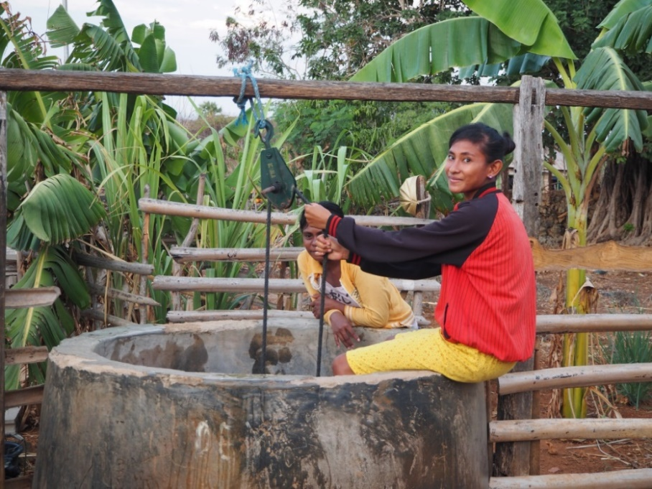
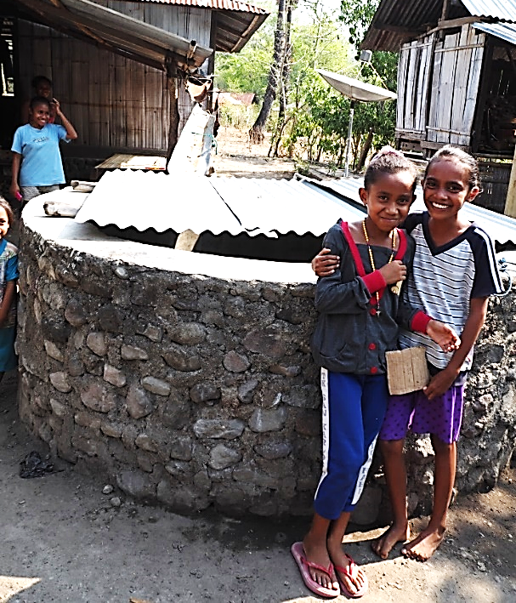
Water and Sanitation
households have access to good sanitation and fresh drinking water
outcomes
maintain good health standards
children attend school more regularly
water also used for plant nurseries and personal vegetable gardens

Slide 8
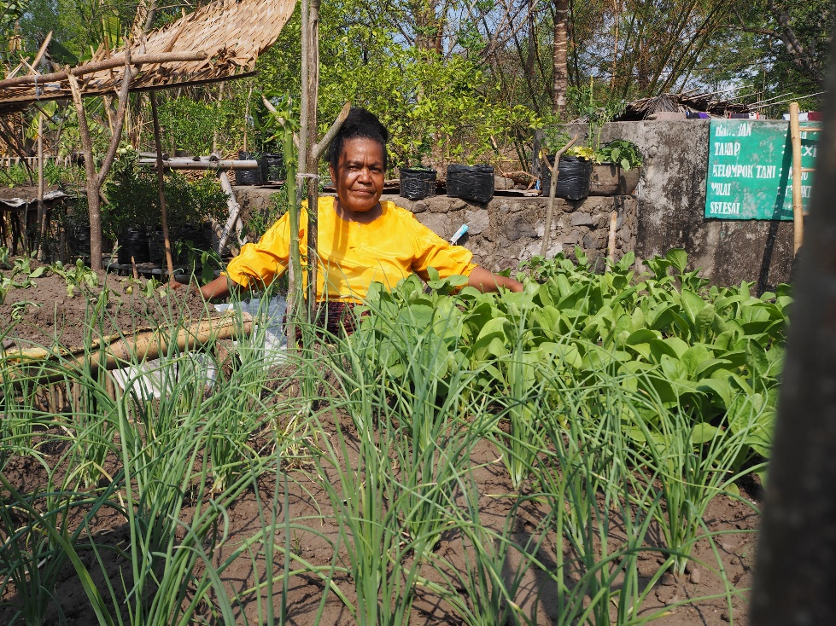
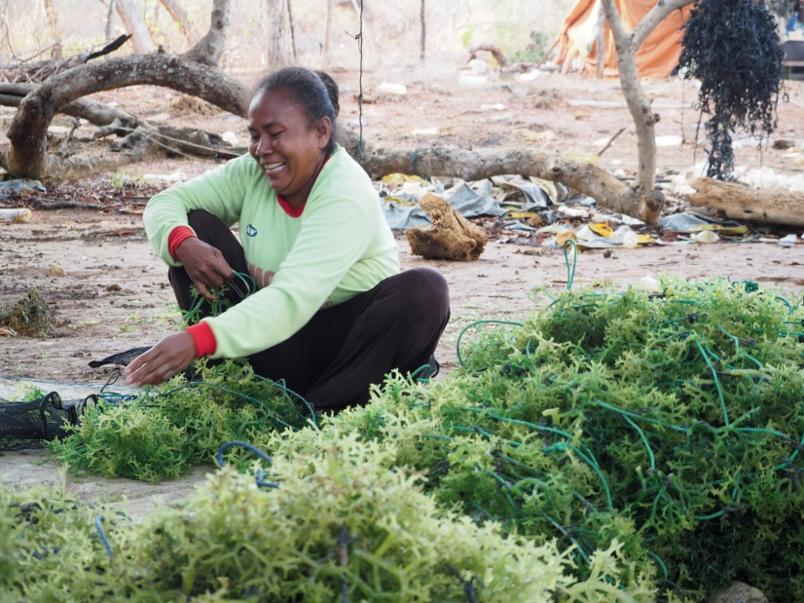
Income generation and food security
Focus on the rural sector particularly
cocoa
vegetables
livestock
seaweed
traditional woven cloths

Slide 9
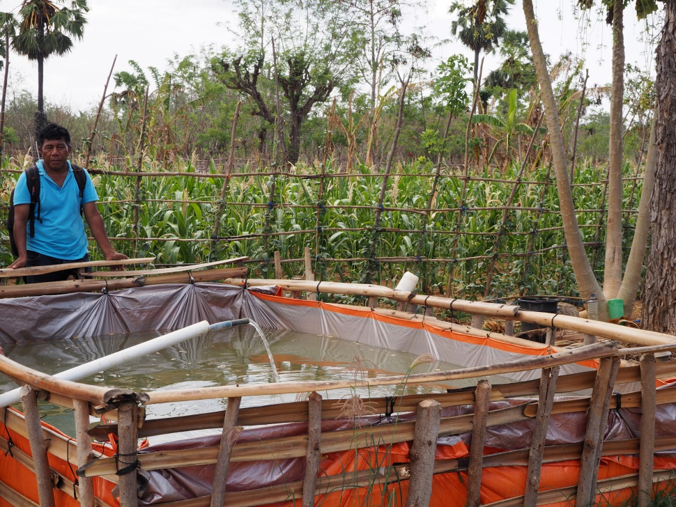
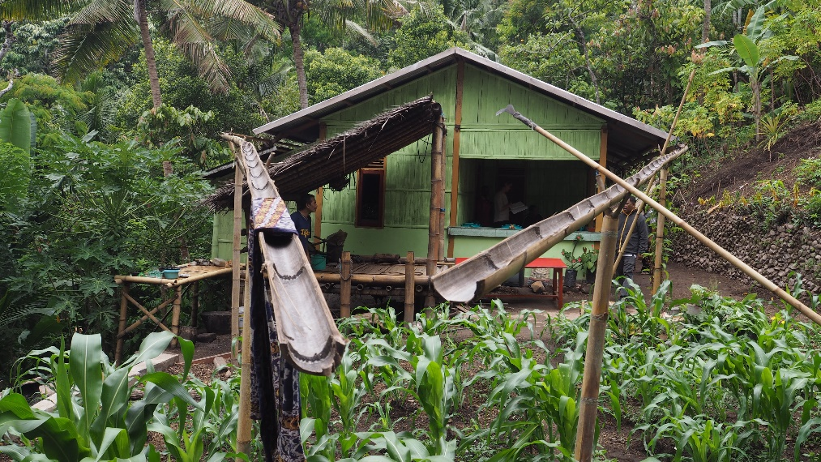
Income generation and food security
small infrastructure projects by local people (water supplies, pumps, household toilets and fences)
rotating credit (temporary loans)
in-country technical expertise
training in business

Slide 10
Education
What we do:
work with:
60 primary & secondary schools (100-150 students each)
16 kindergartens (25-30 students each)
provide libraries, books, scholarships, teacher training, improved facilities & infrastructure

Slide 11
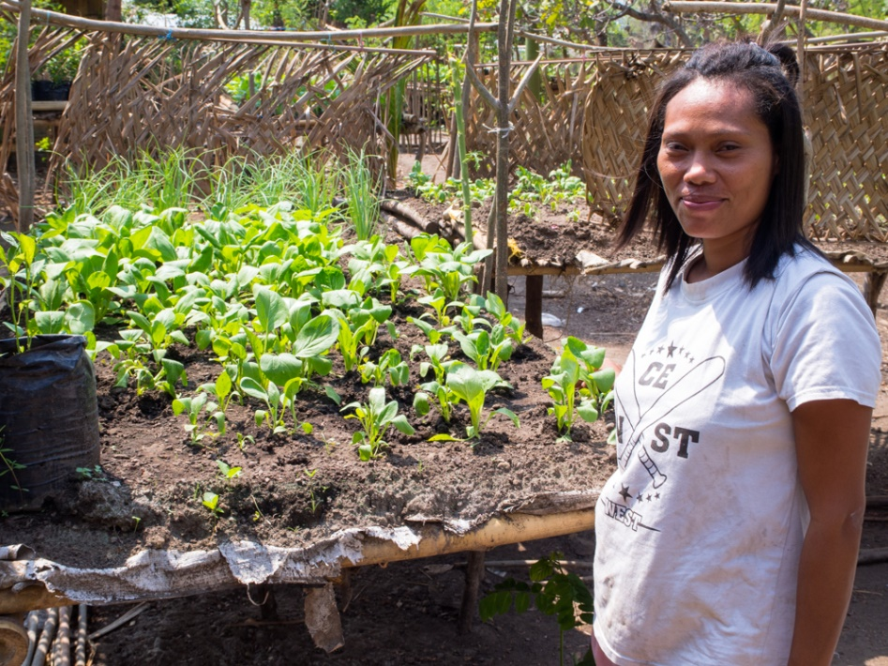
How lives have changed
Ibu Yulia
Habi Village, Flores
40 women in a collective piloted vegetables on bamboo platforms.
NTA supplied off-the-roof water tanks for drinking water. These also provide sufficient water for vegetable growing
Onions, bitter gourd, chillies, aubergine, greens, cucumbers and marrows
Initial results include:
additional food for families
household income up 20-30%.

Slide 12
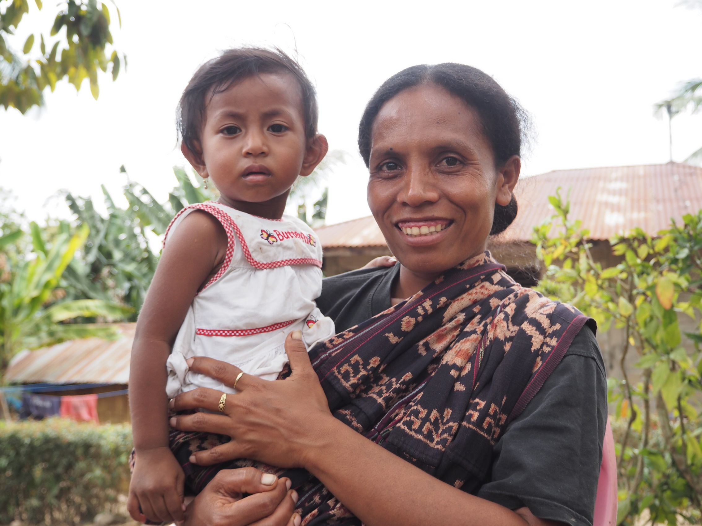
Thank you and hope you will help

